Slide 1

Project Presentation Week 2
Lilian Mirabel – Florian Chapoullie-Pino
Luc Lacotte – Floris Rimbeau
1

Slide 2
Links between collections via SKU
Week 2 Objective
The main objective of this sprint is to integrate AI-driven automation into the retail inventory management system.
Enable the AI agent to analyze sales and stock data to identify at-risk SKUs.
Automatically generate purchase orders through the backend MCP layer.
Deliver a functional dashboard that provides visibility into stock levels, purchase orders and key performance metrics.
Notes:
floris

Slide 3

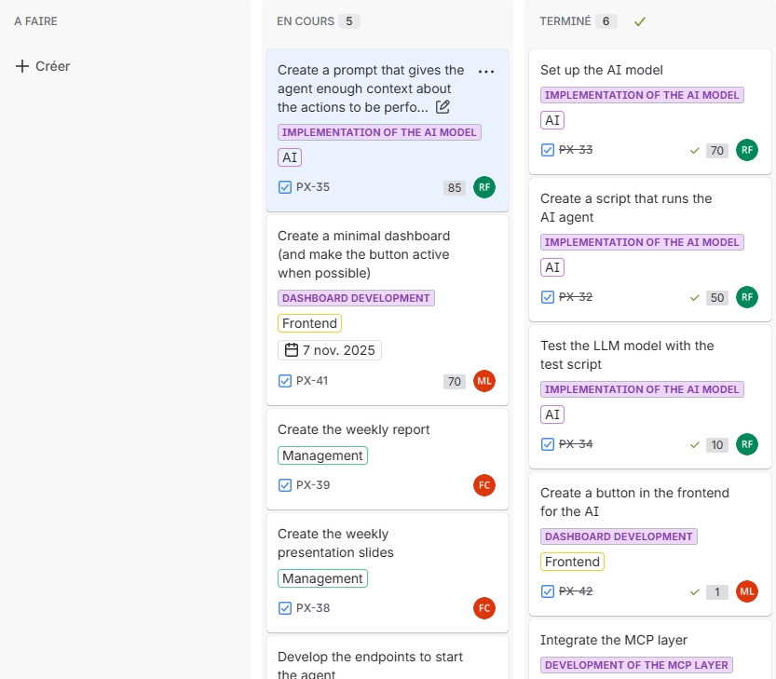
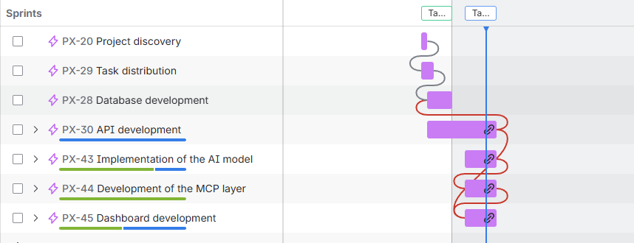
Organisation
We have organised ourselves with Jira for the distribution of work.
3
Notes:
Luc

Slide 4
Distribution of tasks
Luc : API development, MCP layer
Floris : AI Agent implementation
Florian : Project management & front-end development
Lilian : Front-end development
Notes:
luc

Slide 5



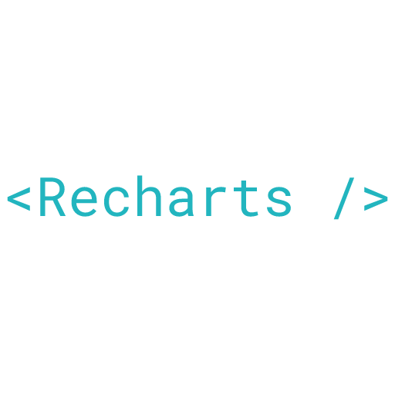
Minimalist Dashboard
React
Daisy UI
Tailwind CSS
5
Notes:
lilian

Slide 6
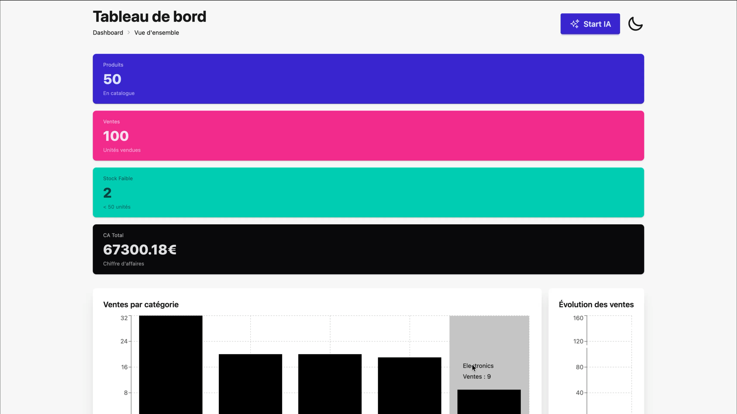
6
Notes:
lilian

Slide 7

AI Agent
Specific docker container
Mistral Agent
Prompt engineering
7
Notes:
lilian

Slide 8
Backend endpoints
New models in the database :
Products Order
Track product order
Add stock when received
New endpoints for stock logic
List of products soon to be out of stock
Stock levels of multiple products
Daily sales of multiple products
Order multiple products
Notes:
floris

Slide 9
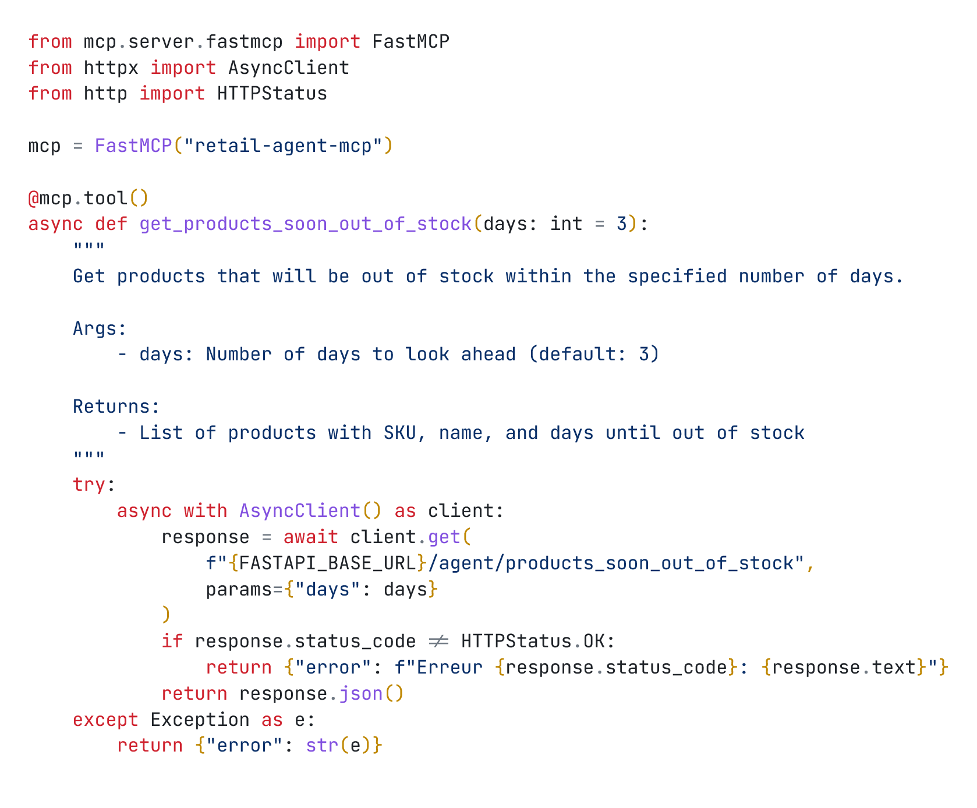
MCP Layer
Specific container alongside the LLM model
Use of the library mcp
Use of the decorator tool
Simulate HTTP calls to the backend
Comment to give context
9
Notes:
lilian

Slide 10
Link the LLM and the MCP
Docker service
initialize LLM and MCP
HTTP request
to start script
LLM generating content
If another query in queue
Save the final answer to history
LLM final answer
Call a tool in the MCP
Notes:
floris

Slide 11
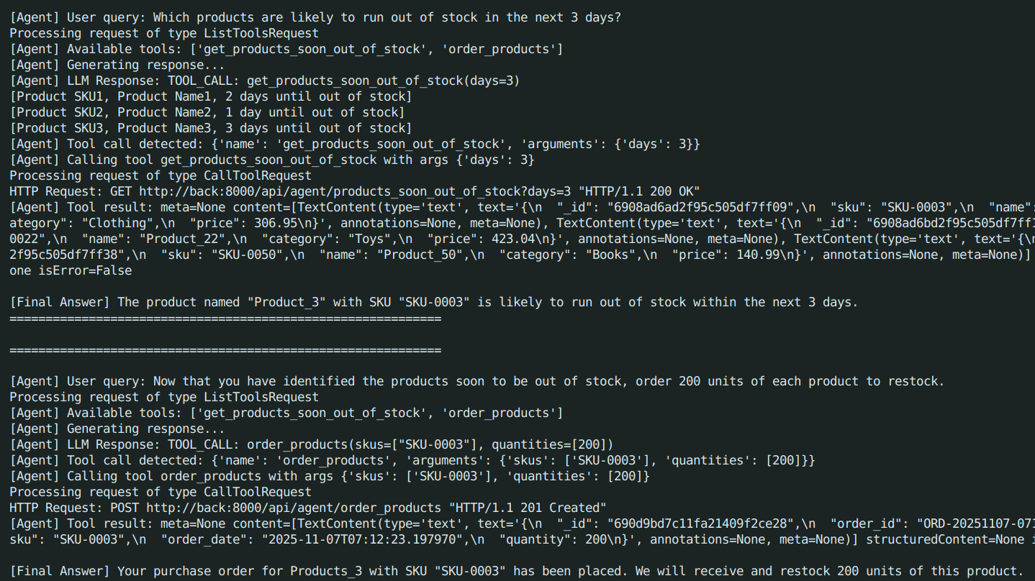
Link the LLM and the MCP
Script that retrieve soon to be out of stock products and order them
Problems encoutered :
Sometimes doesn’t use tools
Doesn’t fully understand the result of a tool
Because of that :
Workflow can be compromised
Not linked yet to the front-end
Very simple script
11
Notes:
lilian

Slide 12
Next steps for Week 3
Key Tasks
Fine-tune agent logic & adaptive decisions
Run simulations & monitor KPIs
Deliverables
Functional autonomous agent
Simulation result
Notes:
florian

Slide 13
Conclusion
The project aims to make strategic decisions to improve productivity.
The project aims to make strategic decisions to improve productivity.
The project aims to make strategic decisions to improve productivity.
The project aims to make strategic decisions to improve productivity.
This sprint helped us strengthen our system and advance the AI agent.
We learned AI automation, backend integration, dashboard development, and API orchestration.
We are now ready for simulations, evaluation, and the final presentation.
Thank you for listening.
13
Notes:
lilian

